Slide 1
GCSE Mathematics 3 year Foundation Tier Routemap (2015 specification)
This Route Map already links to some supporting resources on AQA All About Maths. Further resources will be published along the following timeline
Number
Algebra
Ratio, proportion and rates of change
Geometry and Measures
Probability
Statistics

Slide 2
GCSE Mathematics 3 year Foundation Tier Routemap (2015 specification)
Year 9
Basic Number
Factors and Multiples
Angles
Scale diagrams and bearings
Basic Algebra
Review and Revision 1
Holiday
Basic Fractions
Coordinates
and Linear Graphs
Basic Decimals
Rounding
Collecting and Representing Data
Year 9
Examinations
and Revision
Holiday
Holiday
Sequences
Basic Percentages
Introduction to Perimeter and Area
Review and Revision 2
Holiday
Introduction to Circumference and Area
Ratio and Proportion
Basic Probability
Review and Revision 3
Holiday
Holiday
Equations
Scatter Graphs
Review and Revision 4
Holiday
Transformations
Summer
Examinations
and Revision
Summer
Examinations
and Revision
Pythagoras’ Theorem
2D Representations of 3D Shapes
Year 10

Slide 3
GCSE Mathematics 3 year Foundation Tier Routemap (2015 specification)
Year 10
Review and Revision 5
Standard Form
Calculating with Percentages
Measures
Review and Revision 6
Holiday
Statistical Measures
Indices
Constructions and Loci
Year 10
Examinations
and Revision
Year 10
Examinations
and Revision
Holiday
Holiday
Algebra Recap and Extension
Congruence and Similarity
Introduction to Trigonometry
Review and Revision 7
Holiday
Further Perimeter and Area
Graphs recap and extension
Further Circumference and Area
Review and Revision 8
Holiday
Holiday
Simultaneous Equations
Properties of Polygons
Review and Revision 9
Holiday
Real Life Graphs
Summer
Examinations
and Revision
Summer
Examinations
and Revision
Review of basic Probability
Probability
Year 9
Year 11

Slide 4
GCSE Mathematics 3 year Foundation Tier Routemap (2015 specification)
Year 11
Review and Revision 10
Volume
Algebra: Quadratics, rearranging formulae and Identities
Review and Revision 11
Holiday
Inequalities
Algebra and Graphs
Algebra and Graphs (continued)
Sketching graphs
Mock
Examinations and Revision
Mock
Examinations
and Revision
Direct and Inverse proportion
Trigonometry
Holiday
Holiday
Trigonometry (continued)
Review and Revision 12
Holiday
Solving quadratic equations
Quadratic Graphs
Growth and decay
Review and Revision 13
Holiday
Holiday
Vectors
REVISION
Holiday
REVISION
June
Examinations
June
Examinations
Year 10

Slide 5
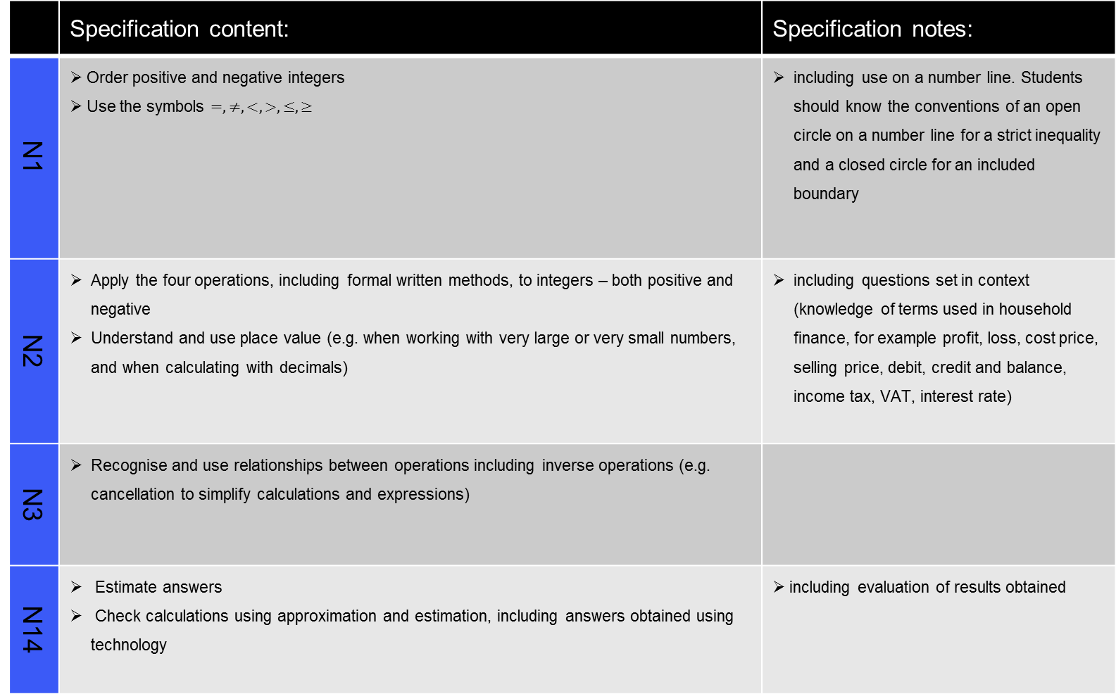
Basic Number
 | Specification content: | Specification notes:
N1 | Order positive and negative integers Use the symbols $=, ≠, <, >, ≤, ≥$ | including use on a number line. Students should know the conventions of an open circle on a number line for a strict inequality and a closed circle for an included boundary
N2 | Apply the four operations, including formal written methods, to integers – both positive and negative Understand and use place value (e.g. when working with very large or very small numbers, and when calculating with decimals) | including questions set in context (knowledge of terms used in household finance, for example profit, loss, cost price, selling price, debit, credit and balance, income tax, VAT, interest rate)
N3 | Recognise and use relationships between operations including inverse operations (e.g. cancellation to simplify calculations and expressions)
N14 | Estimate answers Check calculations using approximation and estimation, including answers obtained using technology | including evaluation of results obtained

Slide 6
Factors and Multiples
 | Specification content: | Specification notes:
N4 | Use the concepts and vocabulary of prime numbers, factors (divisors), multiples, common factors, common multiples, highest common factor, lowest common multiple, prime factorisation, including using product notation, and the unique factorisation theorem | prime factor decomposition including product of prime factors written in index form
N5 | Apply systematic listing strategies | including using lists, tables and diagrams
Resources

Slide 7
Angles
 | Specification content: | Specification notes:
G1 | Use conventional terms and notations: points, lines, vertices, edges, planes, parallel lines, perpendicular lines, right angles, polygons, regular polygons and polygons with reflection and/or rotation symmetries
 | Use the standard conventions for labelling and referring to the sides and angles of triangles Draw diagrams from written descriptions
G3 | Apply the properties of: angles at a point angles at a point on a straight line vertically opposite angles
 | Understand and use alternate and corresponding angles on parallel lines | colloquial terms such as Z angles are not acceptable and should not be used

Slide 8
Scale diagrams and bearings
 | Specification content: | Specification Notes:
R2 | Use scale factors, scale diagrams and maps | including geometrical problems
G15 | Measure line segments and angles in geometric figures, including interpreting maps and scale drawings and use of bearings | including the eight compass point bearings and three-figure bearings

Slide 9
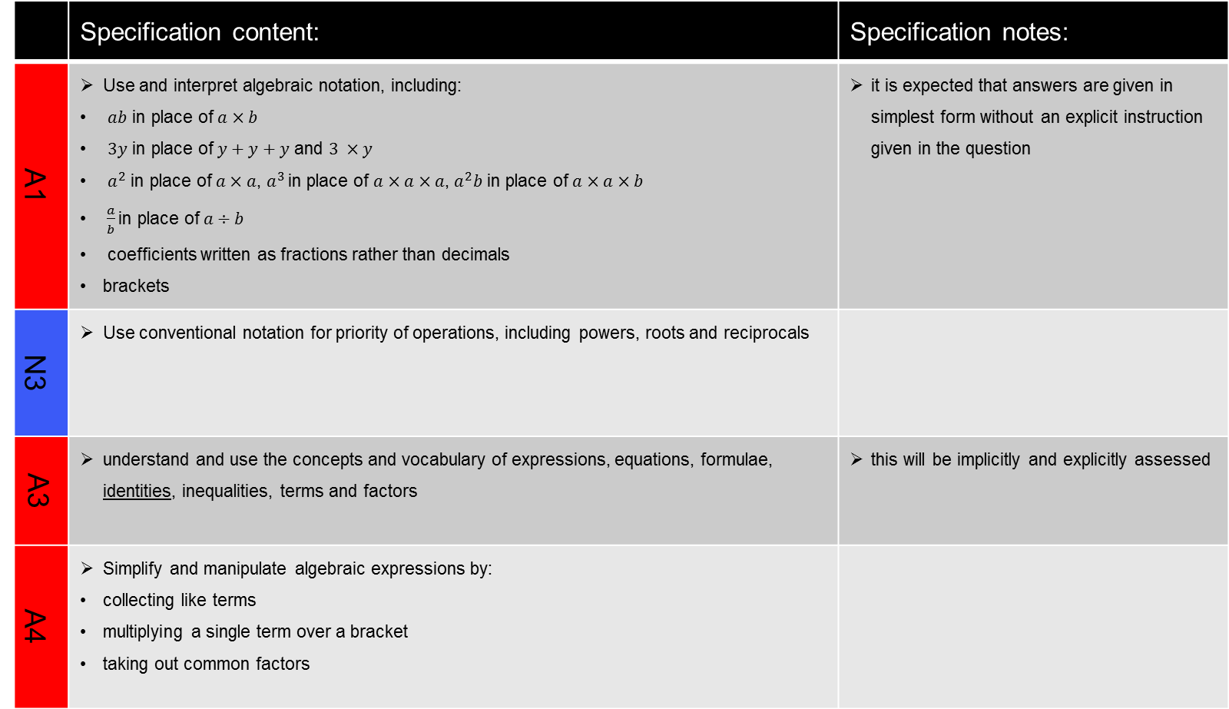
Basic Algebra
 | Specification content: | Specification notes:
A1 | Use and interpret algebraic notation, including: $ab$ in place of $a×b$ $3y$ in place of $y+y+y$ and $3 ×y$ $a^{2}$ in place of $a×a$, $a^{3}$ in place of $a×a×a$, $a^{2}b$ in place of $a×a×b$ $\frac{a}{b}$ in place of $a÷b$ coefficients written as fractions rather than decimals brackets | it is expected that answers are given in simplest form without an explicit instruction given in the question
N3 | Use conventional notation for priority of operations, including powers, roots and reciprocals
A3 | understand and use the concepts and vocabulary of expressions, equations, formulae, identities, inequalities, terms and factors | this will be implicitly and explicitly assessed
A4 | Simplify and manipulate algebraic expressions by: collecting like terms multiplying a single term over a bracket taking out common factors

Slide 10
Review and Revision 1
 | Specification content: | Specification notes:

Slide 11
Basic Fractions
 | Specification content: | Specification notes:
N1 | Order positive and negative fractions
N2 | Apply the four operations, including formal written methods, to simple fractions (proper and improper) and mixed numbers - both positive and negative
N8 | Calculate exactly with fractions

Slide 12
Coordinates and Linear Graphs
 | Specification content: | Specification notes:
A8 | Work with co-ordinates in all four quadrants
G11 | Solve geometrical problems on co-ordinate axes
A9 | Plot graphs of equations that correspond to straight line graphs in the co-ordinate plane

Slide 13
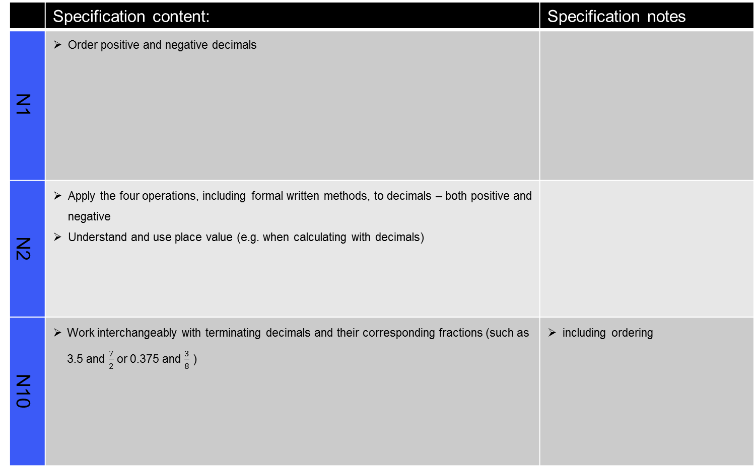
Basic Decimals
 | Specification content: | Specification notes
N1 | Order positive and negative decimals
N2 | Apply the four operations, including formal written methods, to decimals – both positive and negative Understand and use place value (e.g. when calculating with decimals)
N10 | Work interchangeably with terminating decimals and their corresponding fractions (such as 3.5 and $\frac{7}{2}$ or 0.375 and $\frac{3}{8}$ ) | including ordering

Slide 14
Rounding
 | Specification content: | Specification notes:
N15 | Round numbers and measures to an appropriate degree of accuracy (e.g. to a specified number of decimal places or significant figures) Use inequality notation to specify simple error intervals due to truncation or rounding | including appropriate rounding for questions set in context students should know not to round values during intermediate steps of a calculation
N16 | Apply and interpret limits of accuracy

Slide 15
Collecting and Representing Data
 | Specification content: | Specification notes:
S2 | Interpret and construct tables, charts and diagrams including, for categorical data: frequency tables bar charts pie charts pictograms vertical line charts for ungrouped discrete numerical data tables and line graphs for time series data know their appropriate use | including choosing suitable statistical diagrams
S4 | Interpret, analyse and compare distributions of data sets from univariate empirical distributions through appropriate graphical representation involving discrete, continuous and grouped data | know and understand the terms primary data, secondary data, discrete data and continuous data

Slide 16
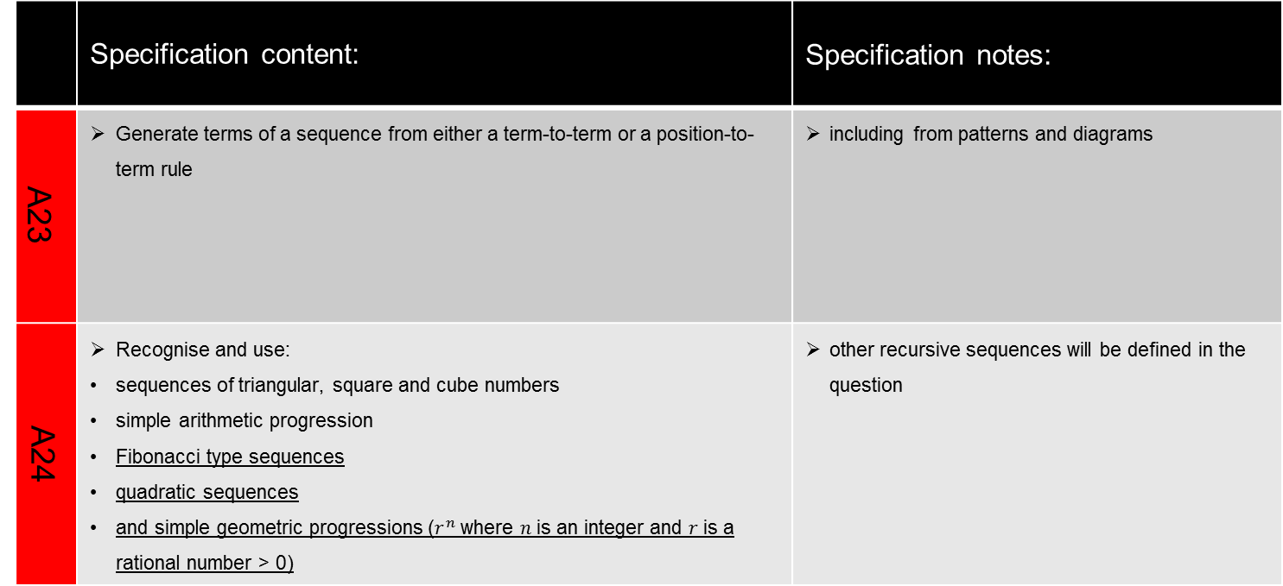
Sequences
 | Specification content: | Specification notes:
A23 | Generate terms of a sequence from either a term-to-term or a position-to-term rule | including from patterns and diagrams
A24 | Recognise and use: sequences of triangular, square and cube numbers simple arithmetic progression Fibonacci type sequences quadratic sequences and simple geometric progressions ($r^{n}$ where $n$ is an integer and $r$ is a rational number > 0) | other recursive sequences will be defined in the question

Slide 17
Basic Percentages
 | Specification content: | Specification notes:
R9 | Define percentage as ‘number of parts per hundred’ Interpret percentages and percentage changes as a fraction or decimal and interpret these multiplicatively Express one quantity as a percentage of another Compare two quantities using percentages Work with percentages greater than 100%
N12 | Interpret fractions and percentages as operators | including interpreting percentage problems using a multiplier

Slide 18
Introduction to Perimeter and Area
 | Specification content: | Specification notes:
G12 | Identify properties of the faces, surfaces, edges and vertices of: cube, cuboids, prisms, cylinders, pyramids, cones and spheres
G17 | Calculate the perimeter of a 2D shape and composite shapes
G16 | Know and apply formulae to calculate area of: triangles parallelograms trapezia
G17 | Calculate the area of composite shapes

Slide 19
Review and Revision 2
 | Specification content: | Specification notes:

Slide 20
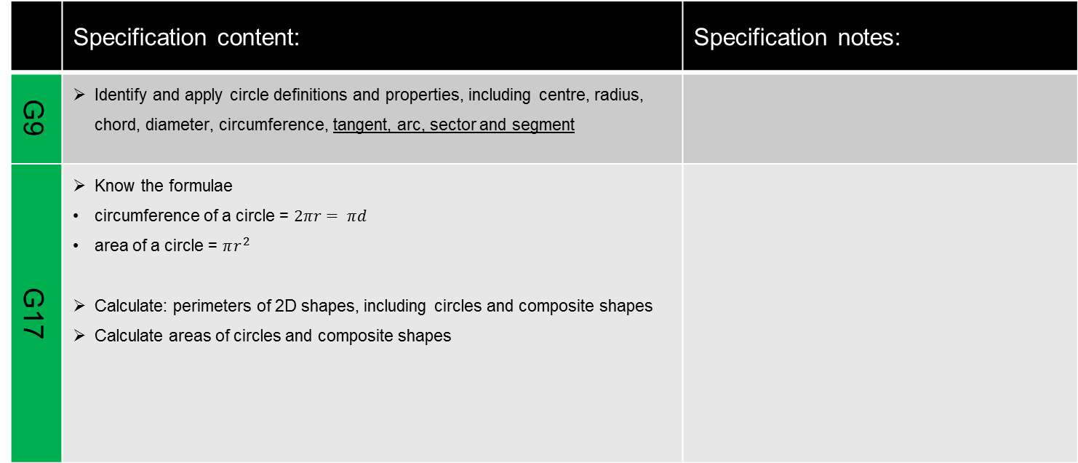
Introduction to Circumference and Area
 | Specification content: | Specification notes:
G9 | Identify and apply circle definitions and properties, including centre, radius, chord, diameter, circumference, tangent, arc, sector and segment
G17 | Know the formulae circumference of a circle = $2πr= πd$ area of a circle = $πr^{2}$ Calculate: perimeters of 2D shapes, including circles and composite shapes Calculate areas of circles and composite shapes
Resources

Slide 21
Ratio and Proportion (Slide 1 of 2)
 | Specification content: | Specification notes:
N11 | Identify and work with fractions in ratio problems
R3 | Express one quantity as a fraction of another, where the fraction is less than 1 or greater than 1
R4 | Use ratio notation, including reduction to simplest form
R5 | Divide a given quantity into two parts in a given part:part or part:whole ratio Express the division of a quantity into two parts as a ratio Apply ratio to real contexts and problems (such as those involving conversion, comparison, scaling, mixing and concentrations) | including better value or best buy problems

Slide 22
Ratio and Proportion (Slide 2 of 2)
 | Specification content: | Specification notes:
R6 | Express a multiplicative relationship between two quantities as a ratio or fraction
R7 | Understand and use proportion as equality of ratios
R8 | Relate ratios to fractions and to linear functions

Slide 23
Basic Probability
 | Specification content: | Specification notes:
P1 | Record, describe and analyse the frequency of outcomes of probability experiments using tables and frequency trees | probabilities should be written as fractions, decimals or percentages
P4 | Apply the property that the probabilities of an exhaustive set of outcomes sum to one Apply the property that the probabilities of an exhaustive set of mutually exclusive events sum to one
P7 | Construct theoretical possibility spaces for single and combined experiments with equally likely outcomes and use these to calculate theoretical probabilities

Slide 24
Review and Revision 3
 | Specification content: | Specification notes:

Slide 25
Equations
 | Specification content: | Specification notes:
A2 | Substitute numerical values into formulae and expressions, including scientific formulae | unfamiliar formulae will be given in the question
A17 | Solve linear equations in one unknown algebraically including those with the unknown on both sides of the equation | including use of brackets

Slide 26
Scatter Graphs
 | Specification content: | Specification notes:
S6 | Use and interpret scatter graphs of bivariate data Recognise correlation and know that it does not indicate causation | know and understand the terms positive correlation, negative correlation, no correlation, weak correlation and strong correlation
 | Draw estimated lines of best fit Make predictions Interpolate and extrapolate apparent trends whilst knowing the dangers of doing so

Slide 27
Review and Revision 4
 | Specification content: | Specification notes:

Slide 28
Transformations
 | Specification content: | Specification notes:
G7 | Identify, describe and construct congruent and similar shapes, on co-ordinate axes, by considering rotation, reflection, translation and enlargement (including fractional scale factors)
G24 | Describe translations as 2D vectors

Slide 29
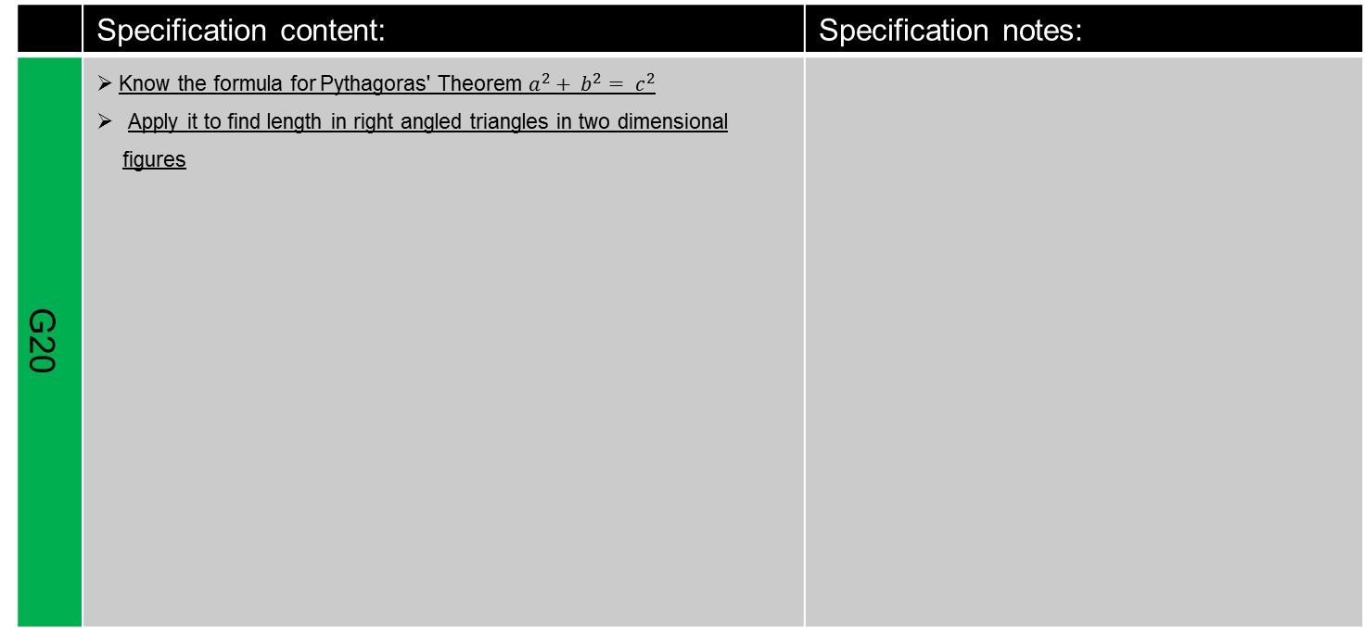
Pythagoras Theorem
 | Specification content: | Specification notes:
G20 | Know the formula for Pythagoras' Theorem $a^{2}+ b^{2}= c^{2}$ Apply it to find length in right angled triangles in two dimensional figures

Slide 30
2D Representations of 3D Shapes
 | Specification content: | Specification notes:
G13 | Construct and interpret plans and elevations of 3D shapes

Slide 31
Review and Revision 5
 | Specification content: | Specification notes:

Slide 32
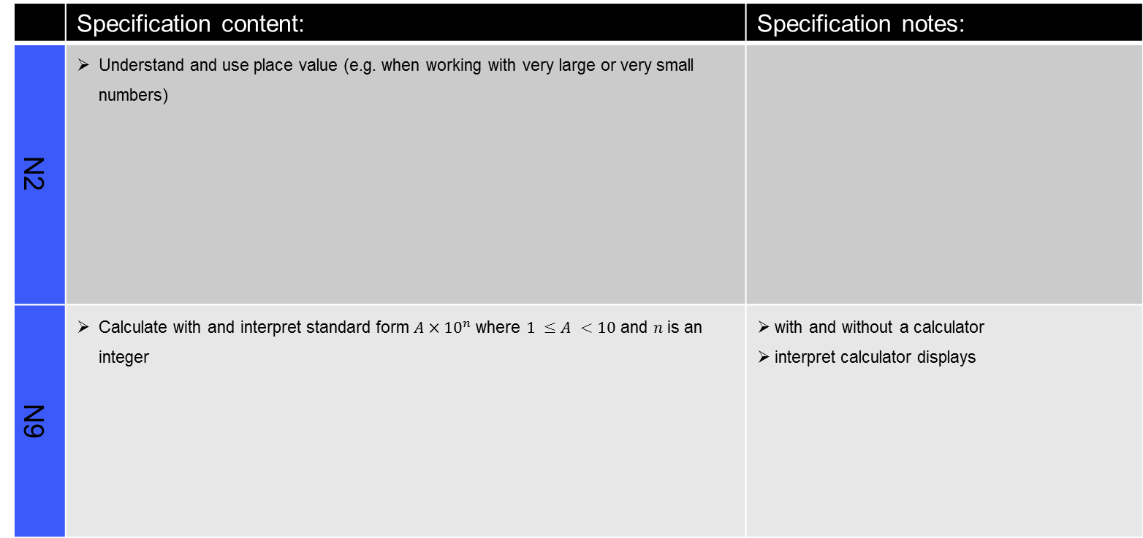
Standard Form
 | Specification content: | Specification notes:
N2 | Understand and use place value (e.g. when working with very large or very small numbers)
N9 | Calculate with and interpret standard form $A×{10}^{n}$ where $1 ≤A <10$ and $n$ is an integer | with and without a calculator interpret calculator displays

Slide 33
Calculating with Percentages
 | Specification content: | Specification notes:
R9 | Solve problems involving percentage change, including: percentage increase / decrease problems original value problems simple interest, including in financial mathematics problems set in context using a multiplier

Slide 34
Continued on next page
Measures (Slide 1 of 2)
 | Specification content: | Specification notes:
N16 | Apply and interpret limits of accuracy
G14 | Use standard units of measure and related concepts (length, area, volume / capacity, mass, time, money etc)
N13 | Use standard units of mass, length, time, money and other measures (including standard compound measures) using decimal quantities where appropriate | know and use metric conversion factors for length, area, volume and capacity. Imperial / metric conversions will be given in the question
View next page

Slide 35
Measures (Slide 2 of 2)
 | Specification content: | Specification notes:
R1 | Change freely between related standard units (e.g. time, length, area, volume / capacity, mass) and compound units (e.g. speed, rates of pay, prices, density, pressure) in numerical and algebraic contexts
R11 | Use compound units such as speed, rates of pay, unit pricing, density and pressure | including making comparisons
Return to previous page

Slide 36
Review and Revision 6
 | Specification content: | Specification notes:

Slide 37
Statistical Measures
 | Specification content: | Specification notes:
S4 | Interpret, analyse and compare the distributions of data sets from univariate empirical distributions through : appropriate measures of central tendency (median, mean, mode and modal class) spread (range, including consideration of outliers)
S5 | Apply statistics to describe a population
S1 | Infer properties of populations or distributions from a sample, whilst knowing the limitations of sampling

Slide 38
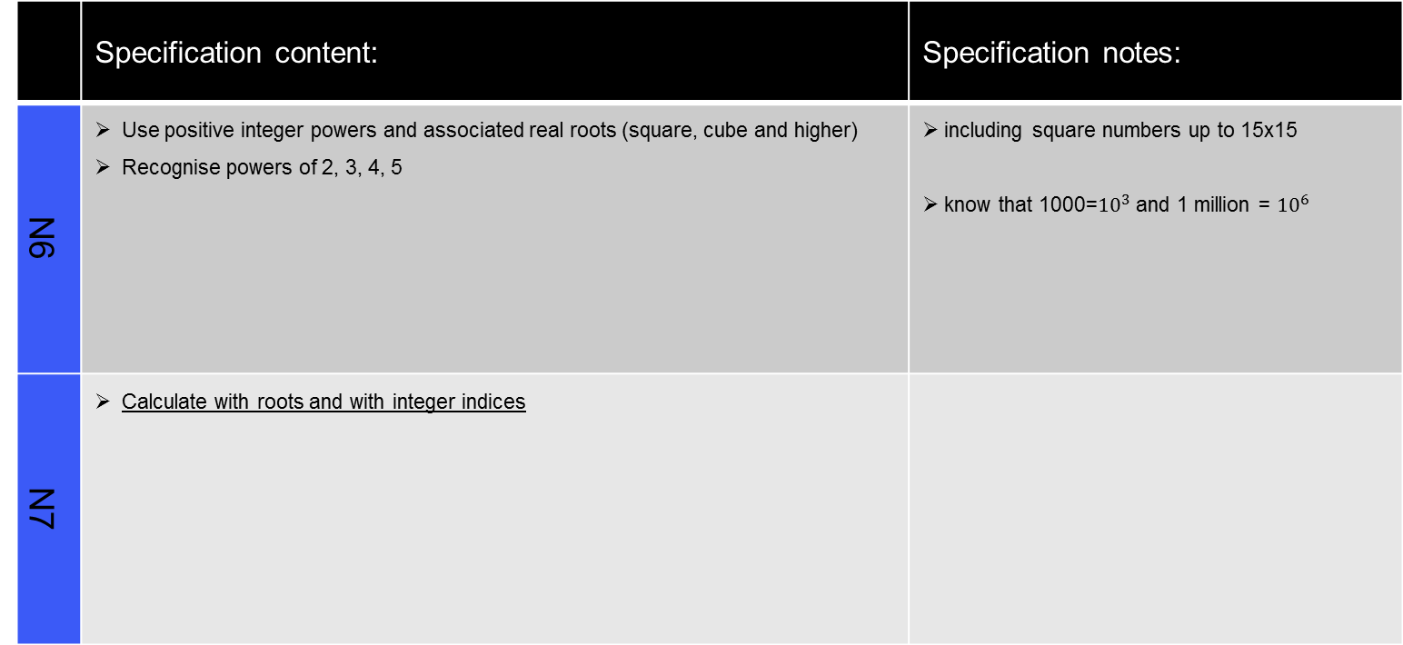
Indices
 | Specification content: | Specification notes:
N6 | Use positive integer powers and associated real roots (square, cube and higher) Recognise powers of 2, 3, 4, 5 | including square numbers up to 15x15 know that 1000=${10}^{3}$ and 1 million = ${10}^{6}$
N7 | Calculate with roots and with integer indices

Slide 39
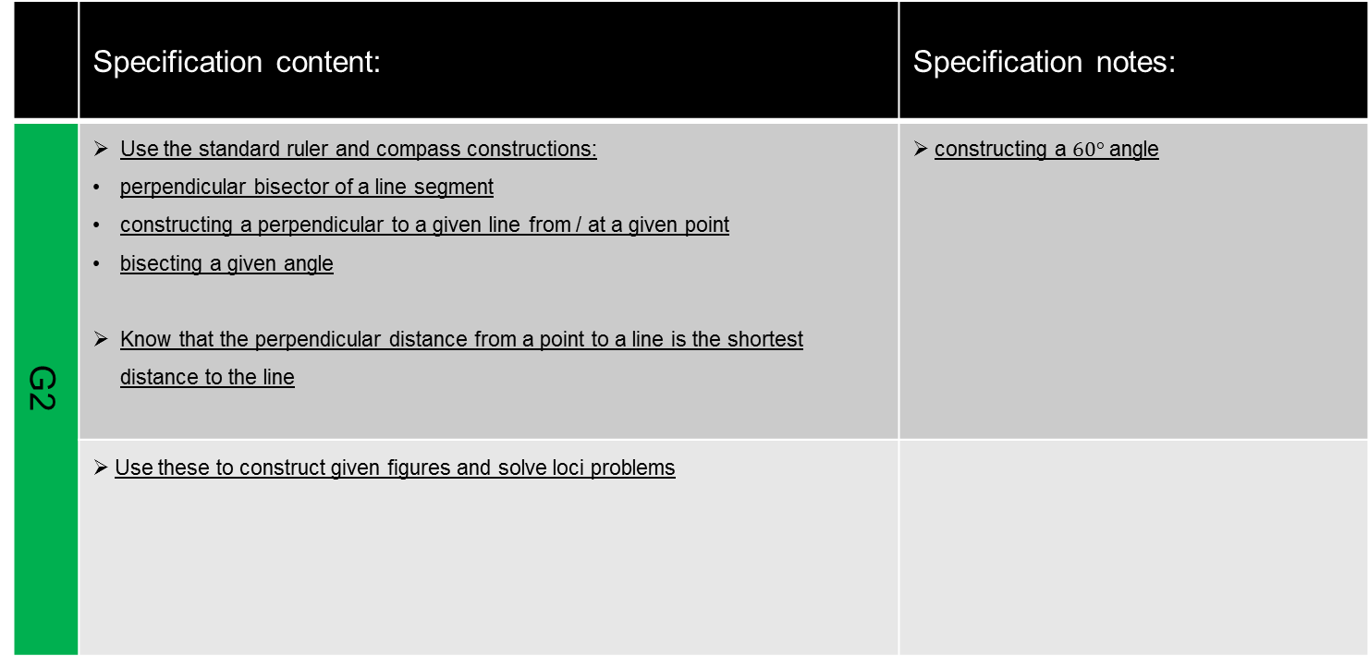
Constructions and Loci
 | Specification content: | Specification notes:
G2 | Use the standard ruler and compass constructions: perpendicular bisector of a line segment constructing a perpendicular to a given line from / at a given point bisecting a given angle Know that the perpendicular distance from a point to a line is the shortest distance to the line | constructing a $60°$ angle
 | Use these to construct given figures and solve loci problems

Slide 40
Algebra Recap and Extension
 | Specification content: | Specification notes:
A3 | Understand and use the concepts and vocabulary of expressions, equations, formulae, identities, inequalities, terms and factors (review of Year 9) | this will be implicitly and explicitly assessed
A4 | Simplify and manipulate algebraic expressions (including those involving surds) by: collecting like terms multiplying a single term over a bracket taking out common factors
A25 | Deduce expressions to calculate the nth term of a linear sequence
A17 | Solve linear equations in one unknown algebraically including those with the unknown on both sides of the equation (review of Year 9) | including use of brackets

Slide 41
Congruence and Similarity
 | Specification content: | Specification notes:
G5 | Use the basic congruence criteria for triangles (SSS, SAS, ASA, RHS)
G6 | Apply angle facts, triangle congruence, similarity and properties of quadrilaterals to conjecture and derive results about angles and sides including Pythagoras’ Theorem and the fact that the base angles of an isosceles triangle are equal, and use known results to obtain simple proofs
G19 | Apply and use the concepts of congruence and similarity, including the relationships between lengths in similar figures
Resources

Slide 42
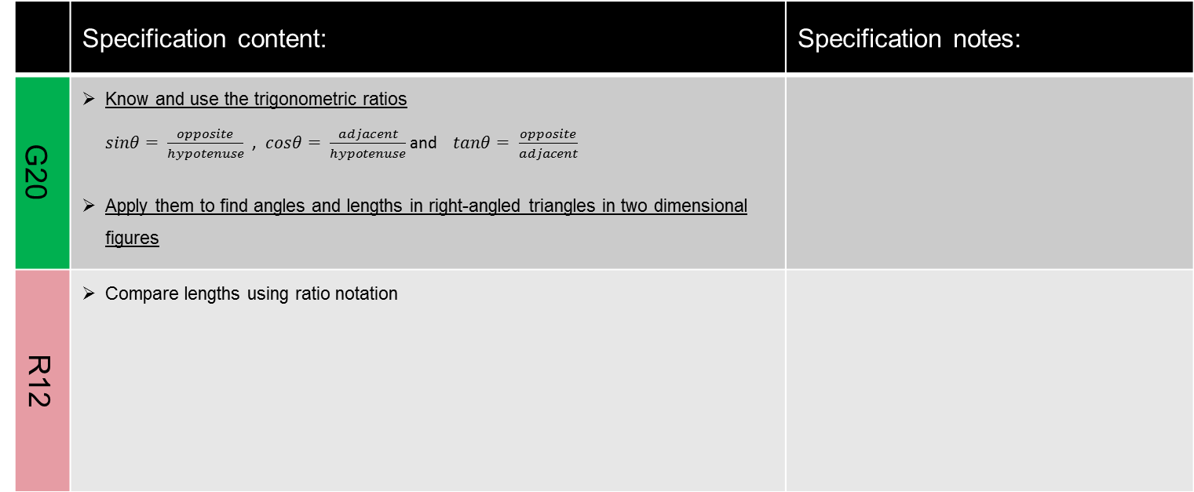
Introduction to trigonometry
 | Specification content: | Specification notes:
G20 | Know and use the trigonometric ratios $sinθ= \frac{opposite}{hypotenuse}$ , $cosθ= \frac{adjacent}{hypotenuse}$ and $tanθ= \frac{opposite}{adjacent}$ Apply them to find angles and lengths in right-angled triangles in two dimensional figures
R12 | Compare lengths using ratio notation

Slide 43
Review and Revision 7
 | Specification content: | Specification notes:

Slide 44
Further Perimeter and Area
 | Specification content: | Specification notes:
G12 | Identify properties of the faces, surfaces, edges and vertices of: cube, cuboids, prisms, cylinders, pyramids, cones and spheres (review of Year 9)
G17 | Calculate the perimeter of a 2D shape and composite shapes (review of Year 9)
G16 | Know and apply formulae to calculate area of: triangles parallelograms trapezia (review of Year 9)
G17 | Calculate the area of composite shapes (review of Year 9) Find the surface area of pyramids and composite solids

Slide 45
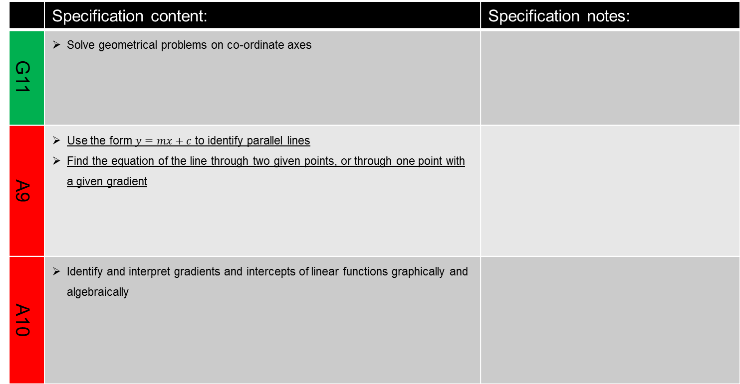
Graphs Recap and Extension
 | Specification content: | Specification notes:
G11 | Solve geometrical problems on co-ordinate axes
A9 | Use the form $y=mx+c$ to identify parallel lines Find the equation of the line through two given points, or through one point with a given gradient
A10 | Identify and interpret gradients and intercepts of linear functions graphically and algebraically

Slide 46
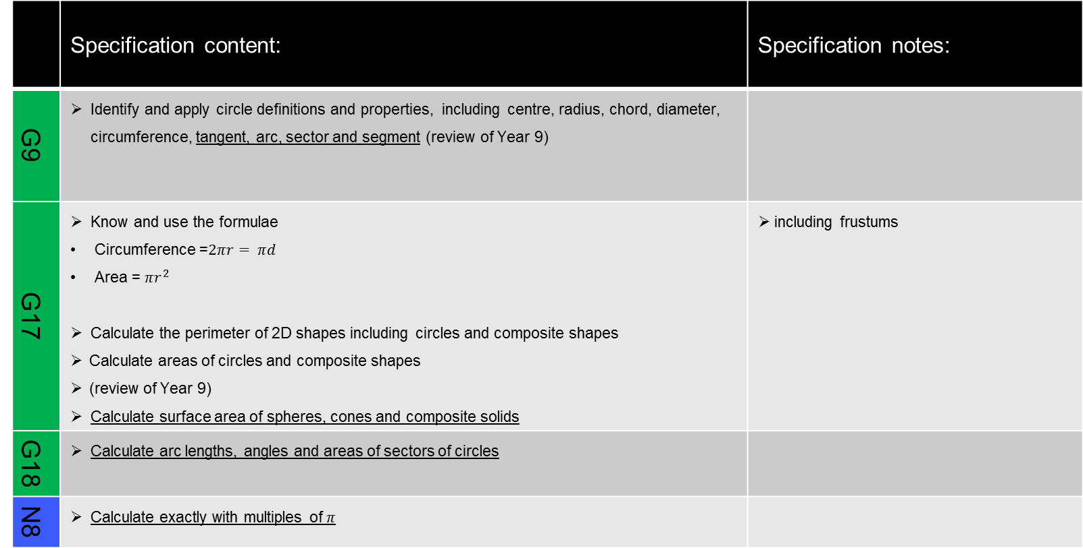
Further Circumference and Area
 | Specification content: | Specification notes:
G9 | Identify and apply circle definitions and properties, including centre, radius, chord, diameter, circumference, tangent, arc, sector and segment (review of Year 9)
G17 | Know and use the formulae Circumference =$2πr= πd$ Area = $πr^{2}$ Calculate the perimeter of 2D shapes including circles and composite shapes Calculate areas of circles and composite shapes (review of Year 9) Calculate surface area of spheres, cones and composite solids | including frustums
G18 | Calculate arc lengths, angles and areas of sectors of circles
N8 | Calculate exactly with multiples of $π$

Slide 47
Review and Revision 8
 | Specification content: | Specification notes:

Slide 48
Simultaneous Equations
 | Specification content: | Specification notes:
A19 | Solve two simultaneous equations in two variables (linear / linear) algebraically Find approximate solutions using a graph | including the approximate solution of a quadratic equation by drawing a straight line to intersect with another quadratic equation
A21 | Translate simple situations or procedures into algebraic expressions or formulae; derive two simultaneous equations Solve the equations and interpret the solution

Slide 49
Properties of Polygons
 | Specification content: | Specification notes
G3 | Derive and use the sum of angles in a triangle (e.g. to deduce and use the angle sum in any polygon, and to derive properties of regular polygons)
G4 | Derive and apply the properties and definitions of: special types of quadrilaterals, including square, rectangle, parallelogram, trapezium, kite and rhombus and triangles and other plane figures using appropriate language | including knowing names and properties of isosceles, equilateral, scalene, right-angled, acute-angled, obtuse-angled triangles including knowing names and using the polygons: pentagon, hexagon, octagon and decagon
Resources

Slide 50
Review and Revision 9
 | Specification content: | Specification notes:

Slide 51
Real Life Graphs
 | Specification content: | Specification notes:
A14 | Plot and interpret graphs (including reciprocal graphs) and graphs of non-standard functions in real contexts, to find approximate solutions to problems such as simple kinematics problems involving distance, speed and acceleration | including problems requiring a graphical solution
R14 | Interpret the gradient of a straight line as a rate of change

Slide 52
Review of basic probability
 | Specification content: | Specification notes:
P1 | Record, describe and analyse the frequency of outcomes of probability experiments using tables and frequency trees (review of Year 9) | probabilities should be written as fractions, decimals or percentages
P4 | Apply the property that the probabilities of an exhaustive set of outcomes sum to one (review of Year 9) Apply the property that the probabilities of an exhaustive set of mutually exclusive events sum to one (review of Year 9)
P7 | Construct theoretical possibility spaces for single and combined experiments with equally likely outcomes and use these to calculate theoretical probabilities (review of Year 9)

Slide 53
Probability
 | Specification content: | Specification notes:
P2 | Apply ideas of randomness, fairness and equally likely events to calculate expected outcomes or multiple future experiments
P3 | Relate relative expected frequencies to theoretical probability, using appropriate language and the 0 – 1 probability scale
P5 | Understand that empirical unbiased samples tend towards theoretical probability distributions with increasing sample size
P6 | Enumerate sets and combinations of sets systematically using tables, grids, Venn diagrams and tree diagrams
P8 | Calculate the probability of independent and dependent combined events, including using tree diagrams and other representations, and know the underlying assumptions | know when to add and when to multiply two or more probabilities
Resources

Slide 54
Review and Revision 10
 | Specification content: | Specification notes:

Slide 55
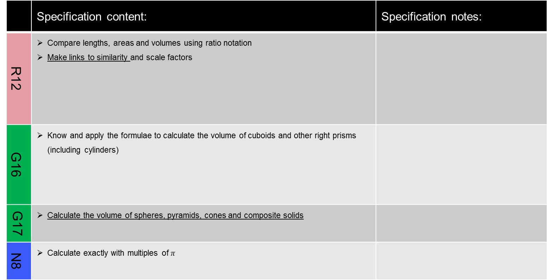
Volume
 | Specification content: | Specification notes:
R12 | Compare lengths, areas and volumes using ratio notation Make links to similarity and scale factors
G16 | Know and apply the formulae to calculate the volume of cuboids and other right prisms (including cylinders)
G17 | Calculate the volume of spheres, pyramids, cones and composite solids
N8 | Calculate exactly with multiples of $π$

Slide 56
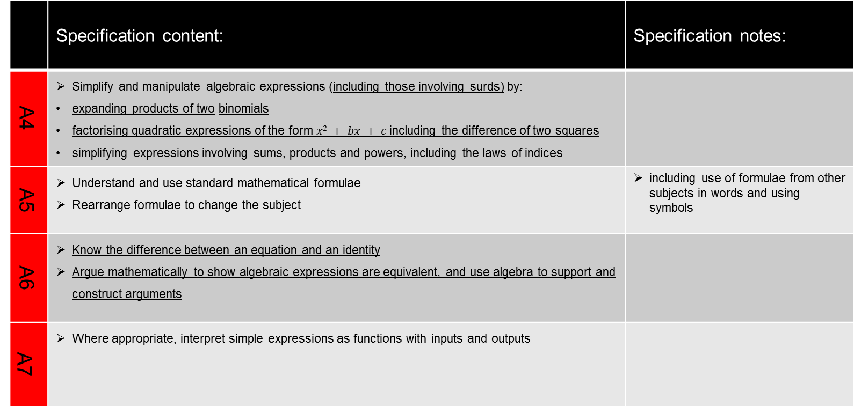
Algebra: Quadratics, Rearranging Formulae and Identities
 | Specification content: | Specification notes:
A4 | Simplify and manipulate algebraic expressions (including those involving surds) by: expanding products of two binomials factorising quadratic expressions of the form $x2 + bx + c$including the difference of two squares simplifying expressions involving sums, products and powers, including the laws of indices
A5 | Understand and use standard mathematical formulae Rearrange formulae to change the subject | including use of formulae from other subjects in words and using symbols
A6 | Know the difference between an equation and an identity Argue mathematically to show algebraic expressions are equivalent, and use algebra to support and construct arguments
A7 | Where appropriate, interpret simple expressions as functions with inputs and outputs

Slide 57
Review and Revision 11
 | Specification content: | Specification notes:

Slide 58
Inequalities
 | Specification content: | Specification notes:
A22 | Solve linear inequalities in one variable Represent the solution set on a number line | know the conventions of an open circle on a number line for a strict inequality and a closed circle for an included boundary

Slide 59
Algebra and graphs
 | Specification content: | Specification notes:
A17 | Solve linear equations in one unknown algebraically Including those with the unknown on both sides of the equation Find approximate solutions using a graph | including use of brackets
A21 | Translate simple situations or procedures into algebraic expressions or formulae; derive an equation (or two simultaneous equations) and the solve the equation(s) and interpret the solution | including solution of geometrical problems and problems set in context

Slide 60
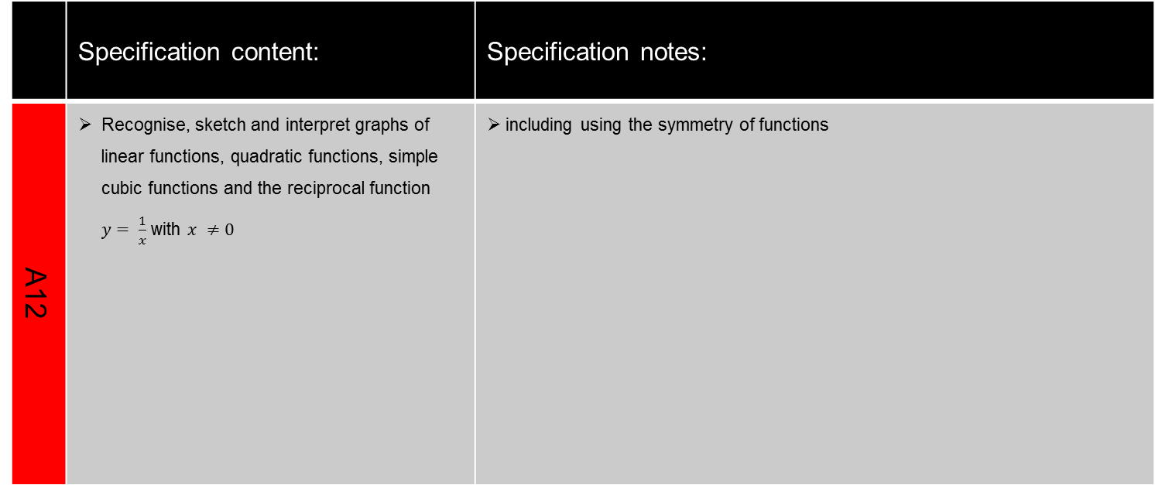
Sketching Graphs
 | Specification content: | Specification notes:
A12 | Recognise, sketch and interpret graphs of linear functions, quadratic functions, simple cubic functions and the reciprocal function $y= \frac{1}{x}$ with $x ≠0$ | including using the symmetry of functions

Slide 61
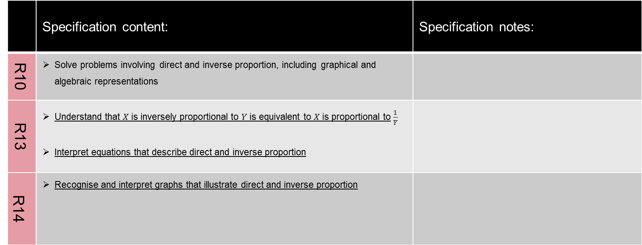
Direct and Inverse Proportion
 | Specification content: | Specification notes:
R10 | Solve problems involving direct and inverse proportion, including graphical and algebraic representations
R13 | Understand that $X$ is inversely proportional to $Y$ is equivalent to $X$ is proportional to $\frac{1}{Y}$ Interpret equations that describe direct and inverse proportion
R14 | Recognise and interpret graphs that illustrate direct and inverse proportion

Slide 62
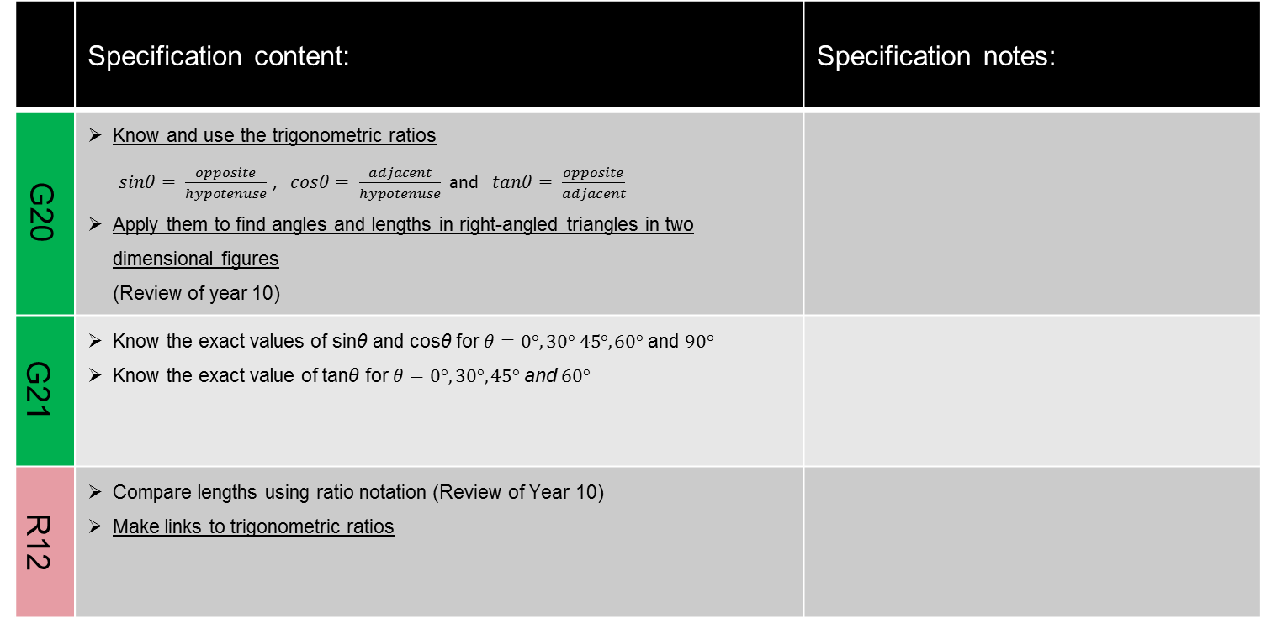
Trigonometry
 | Specification content: | Specification notes:
G20 | Know and use the trigonometric ratios $sinθ= \frac{opposite}{hypotenuse}$ , $cosθ= \frac{adjacent}{hypotenuse}$ and $tanθ= \frac{opposite}{adjacent}$ Apply them to find angles and lengths in right-angled triangles in two dimensional figures (Review of year 10)
G21 | Know the exact values of sinθ and cosθ for $θ=0°, 30° 45°, 60°$ and $90°$ Know the exact value of tanθ for $θ=0°, 30°, 45°$ and $60°$
R12 | Compare lengths using ratio notation (Review of Year 10) Make links to trigonometric ratios

Slide 63
Review and Revision 12
 | Specification content: | Specification notes:

Slide 64
Solving Quadratic Equations
 | Specification content: | Specification notes:
A18 | Solve quadratic equations algebraically by factorising Find approximate solutions using a graph
Resources

Slide 65
Quadratic Graphs
 | Specification content: | Specification notes:
A12 | Recognise, sketch and interpret graphs of quadratic functions
A11 | Identify and interpret roots, intercepts and turning points of quadratic functions graphically Deduce roots algebraically | including the symmetrical property of a quadratic

Slide 66
Growth and Decay
 | Specification content: | Specification notes:
R16 | Set up, solve and interpret the answers in growth and decay problems, including compound interest

Slide 67
Review and Revision 13
 | Specification content: | Specification notes:

Slide 68
Vectors
 | Specification content: | Specification notes:
G25 | Apply addition and subtraction of vectors, multiplication of vectors by a scalar, and diagrammatic and column representation of vectors

